Slide 1

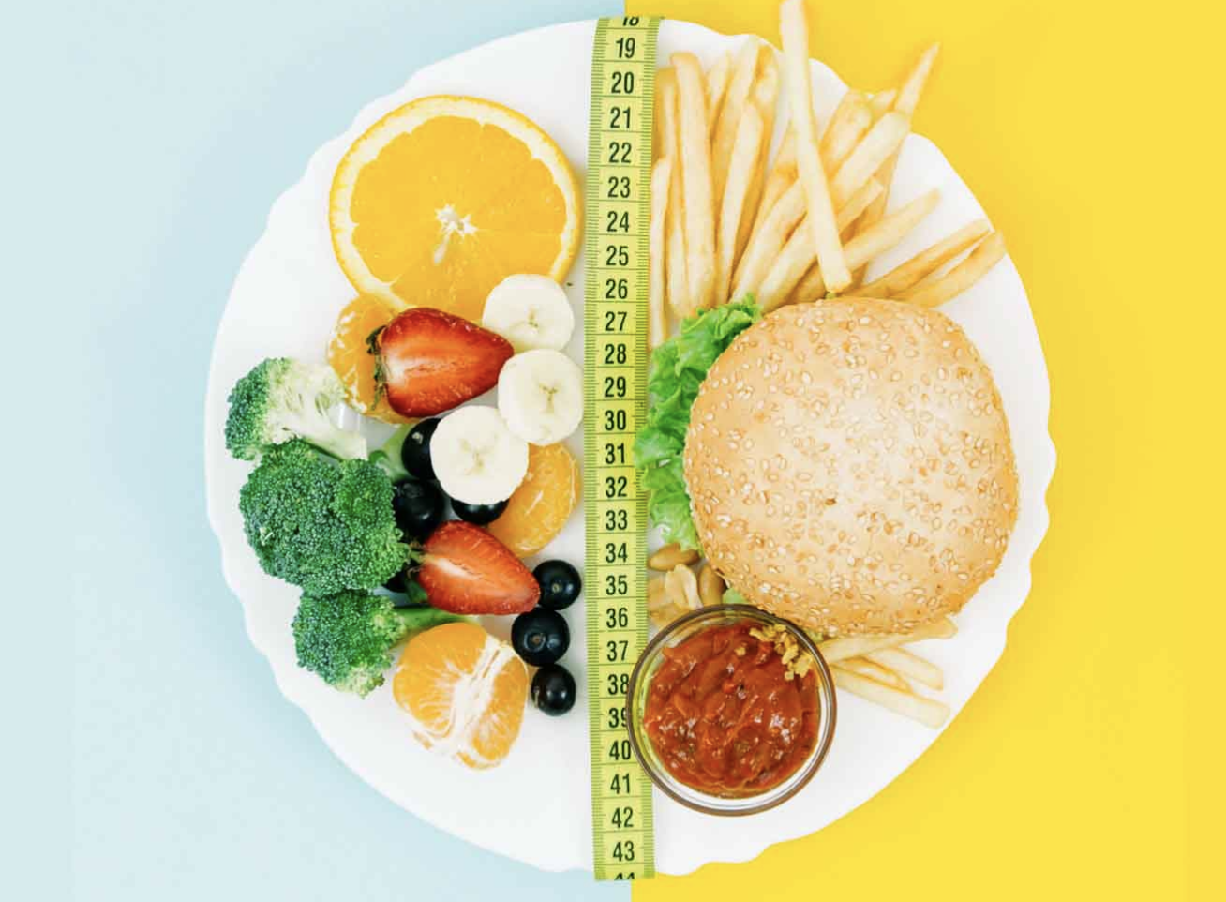

What's in your Plate
Amir Alessia Houleye Paola

Slide 2


Project Overview
In today's fast-paced world, the availability and convenience of fast food have made it a popular choice for many consumers. However, with rising health consciousness, there is growing concern about the nutritional quality of fast food items
The primary objective of this project is to understand the differences in nutritional content between fast foods sold by different restaurants
Which fast food restaurant menu is most likely to contribute to excessive sugar intake?
Are fast food items notoriously low in dietary fiber?
Which restaurant is selling most unhealthy food?
…?

Slide 3


Primary Data Sources:
Fast Food Nutrition Dataset: Nutritional details from major fast food chains.
Comprehensive Nutritional Food Database: Nutrient data for major traditional foods globally.
Top Selling Restaurant Items: Top rated food items
Challenges:
Data Consistency: Standardizing units across datasets.
Nutrient Completeness: Handling missing data through estimation.
Integration: Categorizing fast food compared to traditional food for direct analysis.
Database Table Design: Connecting tables and understanding the primary and foreign key relation in tables
DB Data Upload: The data upload failed because of minor mistakes

Slide 4


Database Design & Data Transformation
Key challenges:
Determining the correct relationships between tables
Make sure every tables are connected with the foreign keys.
Notes:
Key challenges included determining the correct relationships between tables, which led to inconsistencies during data transformation. We addressed these issues by carefully analyzing the data structure and iteratively refining the relationships until they accurately reflected the data's intended connections

Slide 5
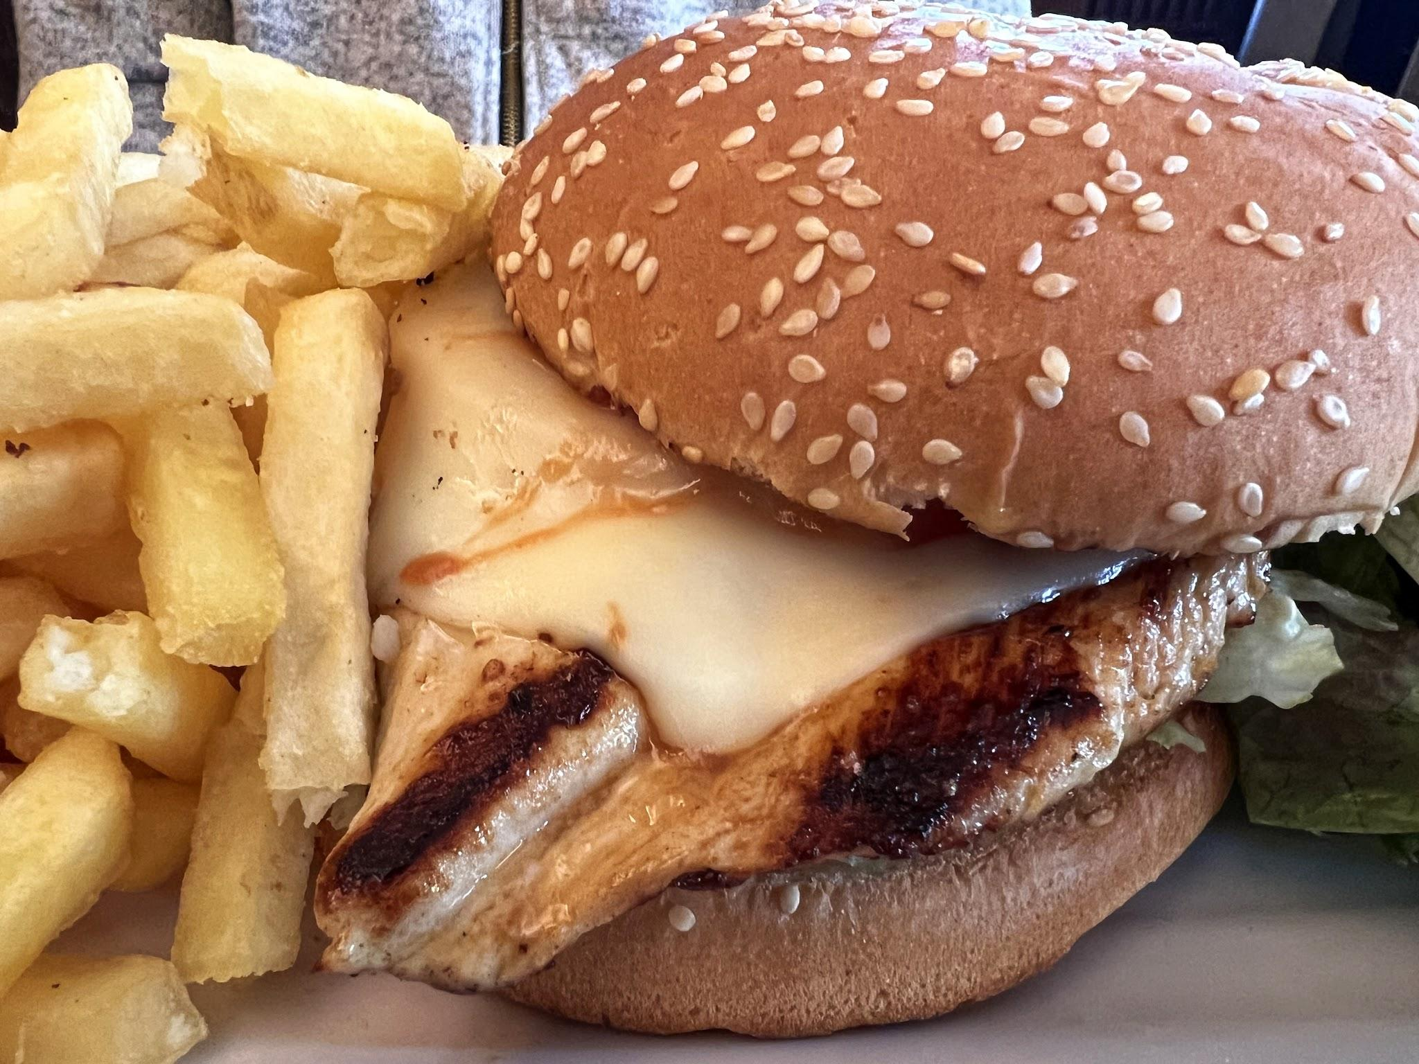
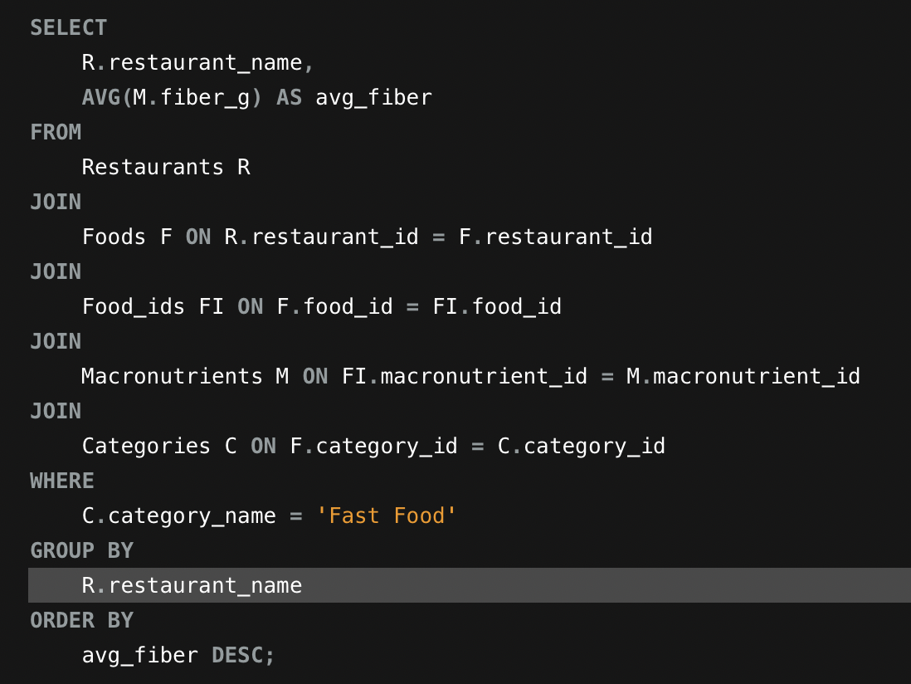
SQL Insights & Advanced Analysis
We identified significant differences in nutritional content between fast food and everyday meals, revealing trends in calorie and fat content. Creating advanced SQL queries with multiple joins was complex, especially when ensuring the correct tables were accurately linked.

Slide 6

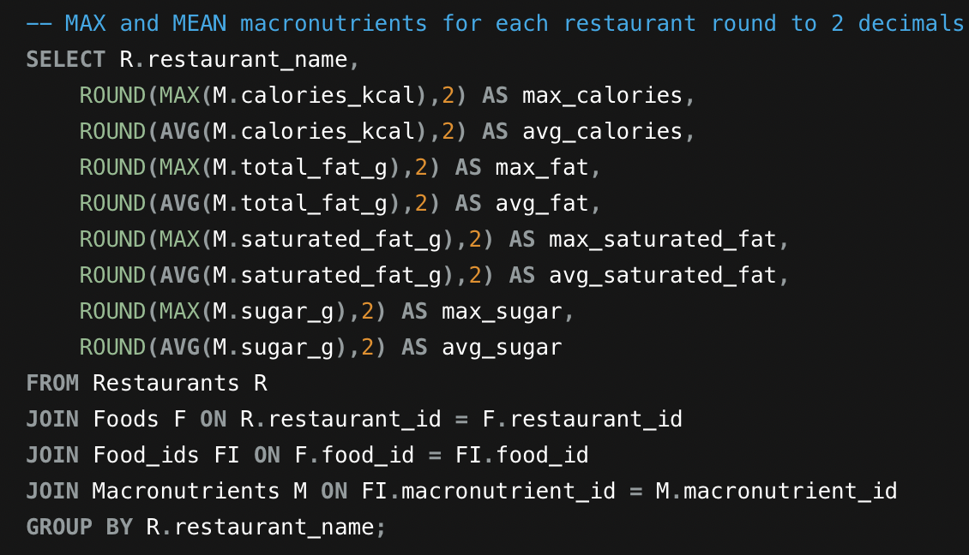
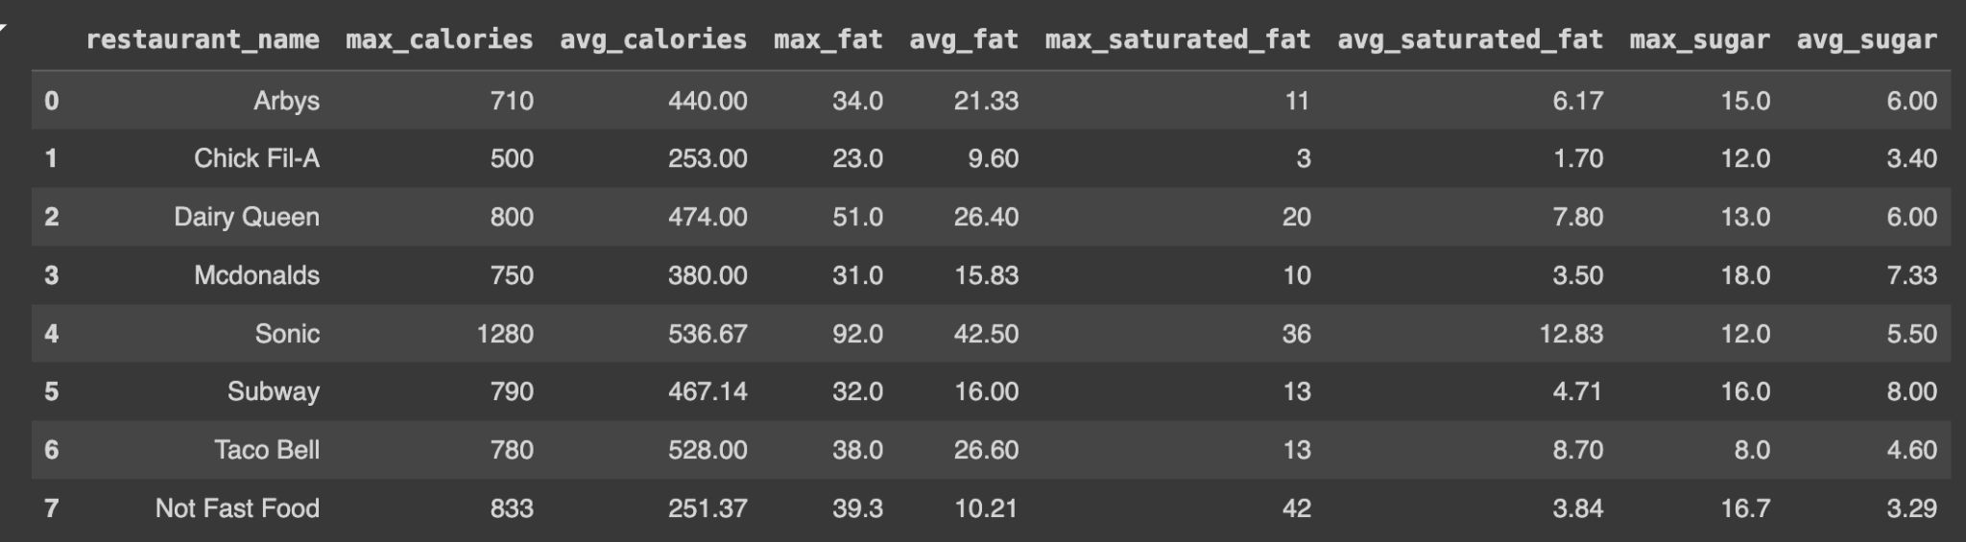
This analysis reveals the nutritional range of each restaurant's menu by showcasing the highest and average values of key macronutrients, offering a snapshot of both peak and typical nutritional content.
- MAX()
- AVG()
- GROUP BY
- INNER JOIN
- ORDER BY

Slide 7

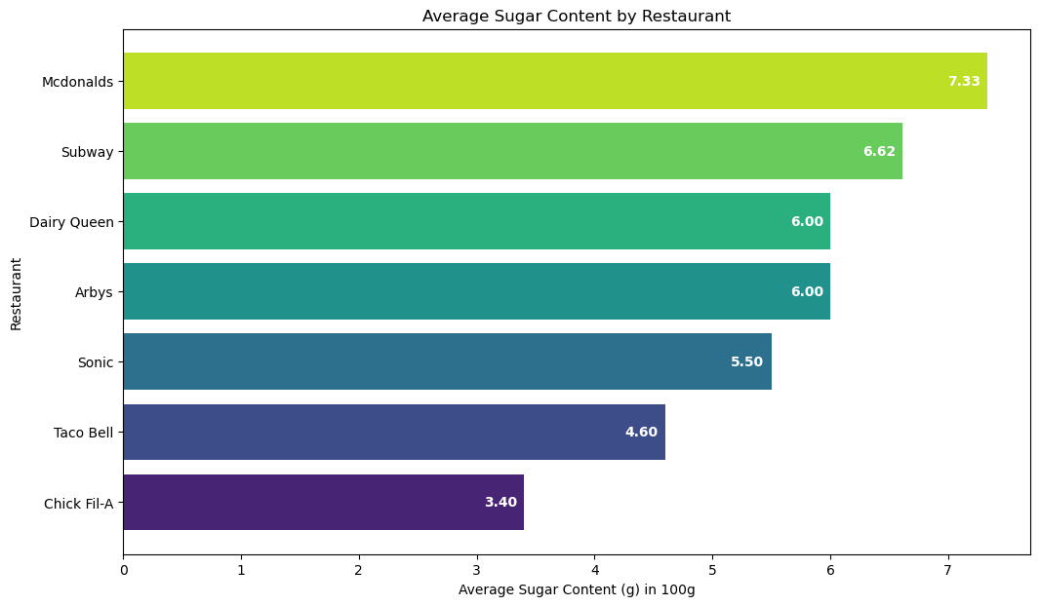
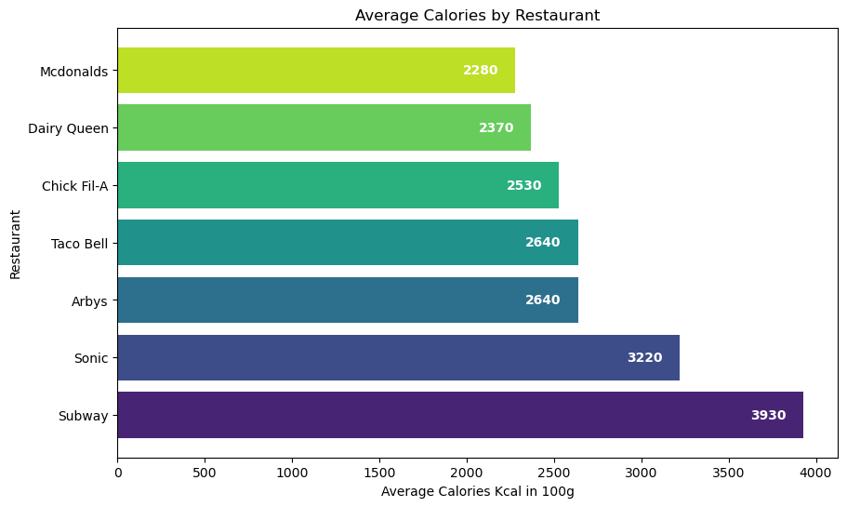
Visualization & Key Insights
🍬 Sweet Spot Winner The restaurant with the lowest average sugar content per food item is: Chick Fil-A
🥗 Leanest Menu Award: The restaurant with the lowest average calorie content per food item is: Mcdonalds

Slide 8

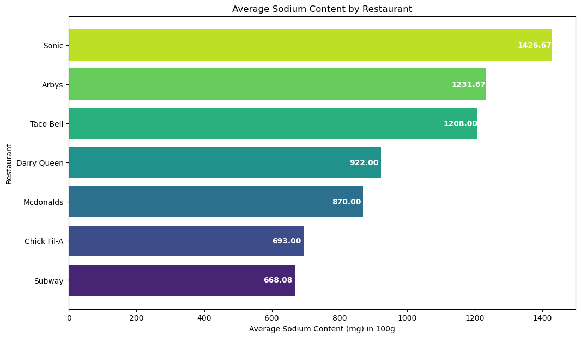
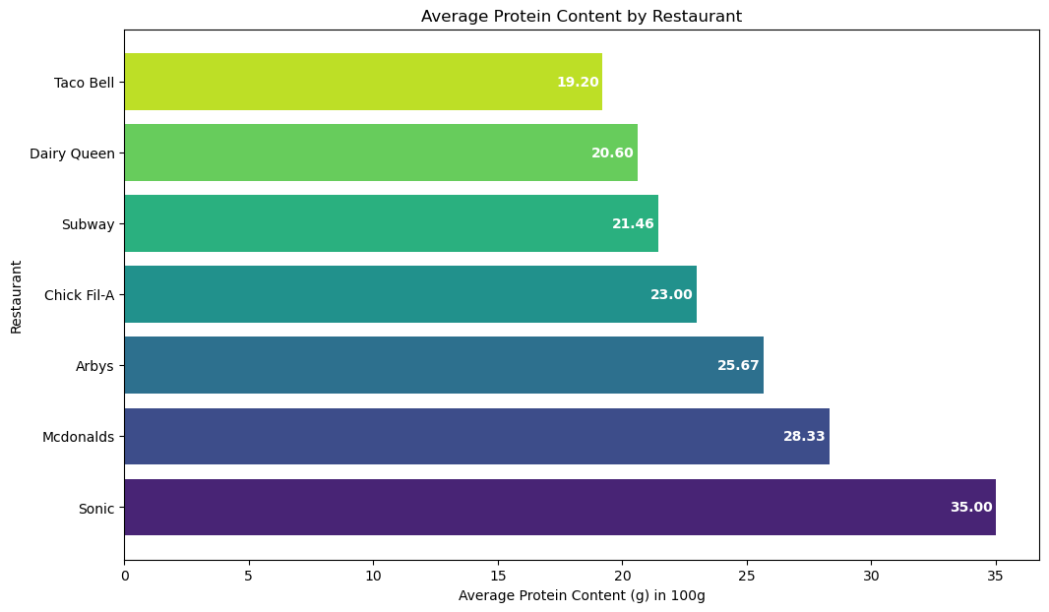
Visualization & Key Insights
🧂 Sodium Sleuth: The restaurant with the lowest average sodium content per food item is: Subway
💪 Protein Powerhouse: The restaurant offering the highest average protein content per meal is: Sonic

Slide 9

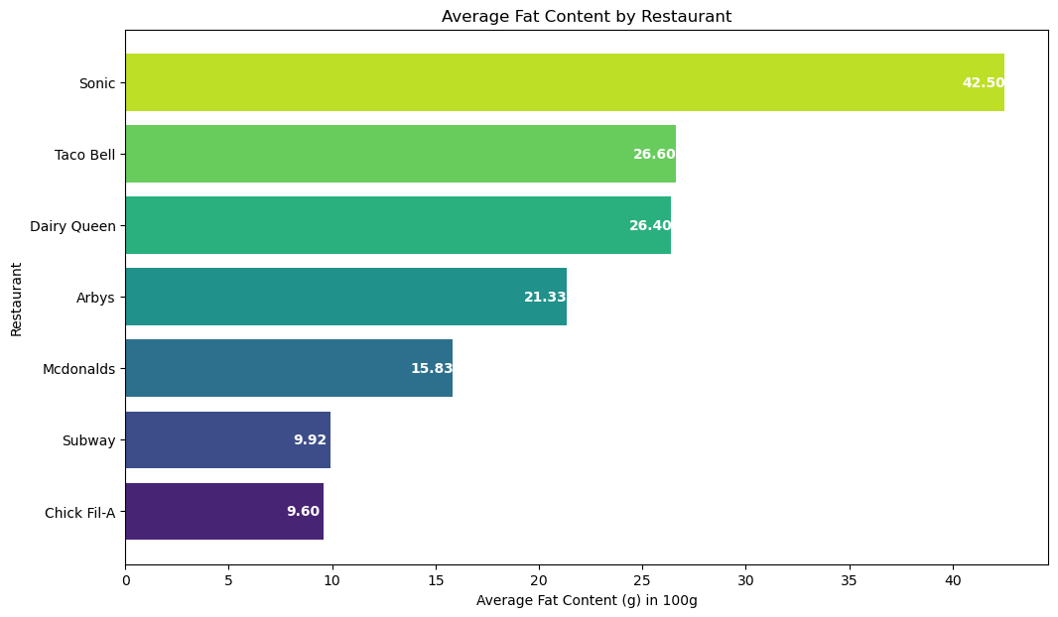
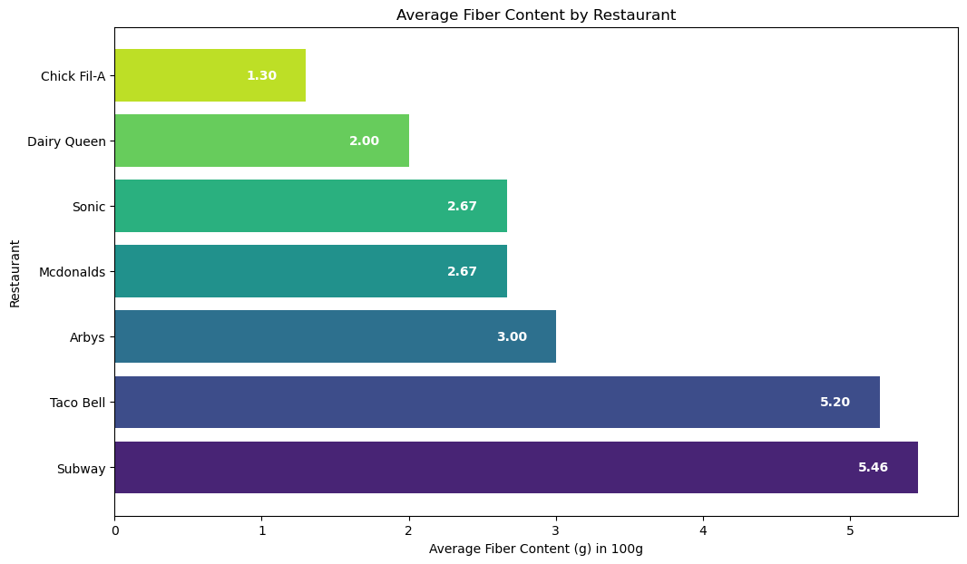
Visualization & Key Insights
🍔 Low-Fat Favorite: The restaurant with the lowest average fat content per food item is: Chick Fil-A
🌾 Fiber Front-Runner: The restaurant with the highest average fiber content per food item is: Subway

Slide 10

Major Obstacle
Biggest Obstacle:
Importing data with foreign keys from CSV files was challenging due to the need for exact matches in table structures. This caused errors when columns or data types didn’t align perfectly.
Lessons Learned:
We learned the importance of validating table structures before importing data. This reinforced the need for careful planning and precise matching to ensure smooth integration.

Slide 11
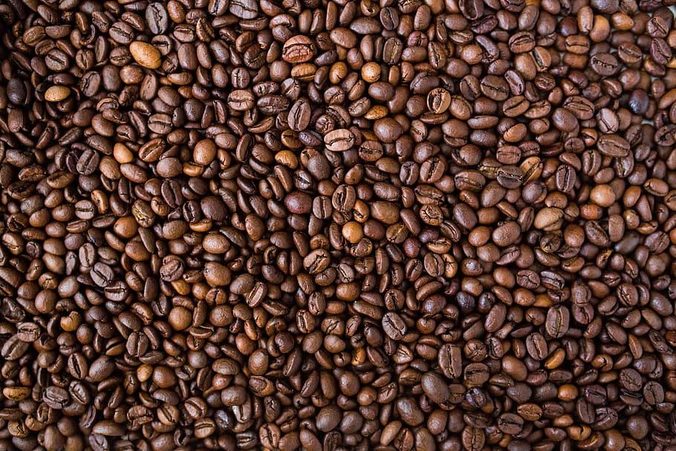

Business Implications
Marketing & Strategy:
Leverage Strengths: Promote nutritional advantages to attract health-conscious consumers.
Menu Innovation: Adjust menus to improve offerings that meet consumer health preferences.
Partnerships & Transparency:
Collaborations: Engage in partnerships with health organizations to promote healthier options.
Transparency: Prioritize clear, accessible nutritional information to build consumer trust.

Slide 12
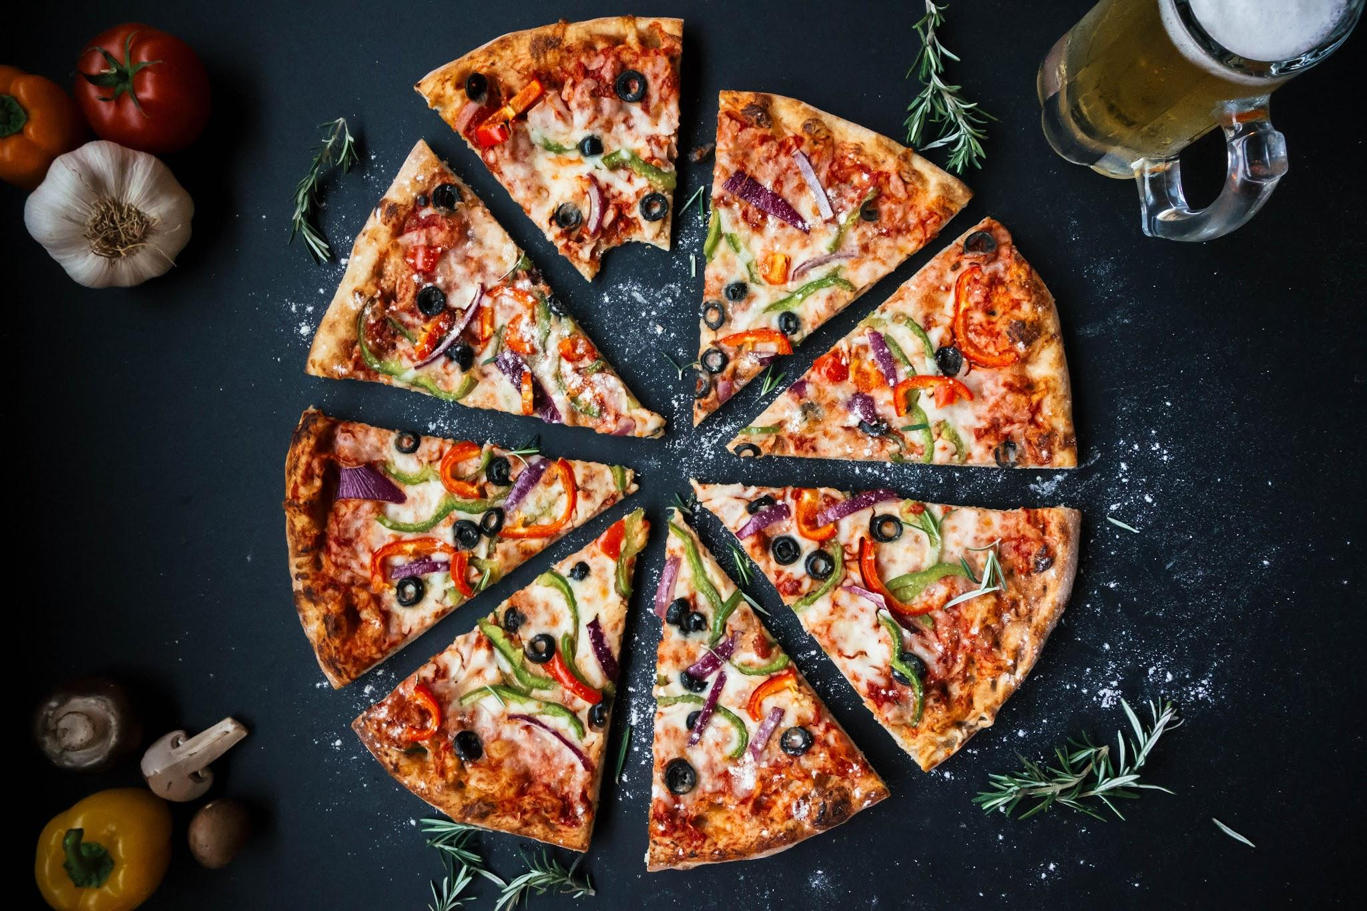
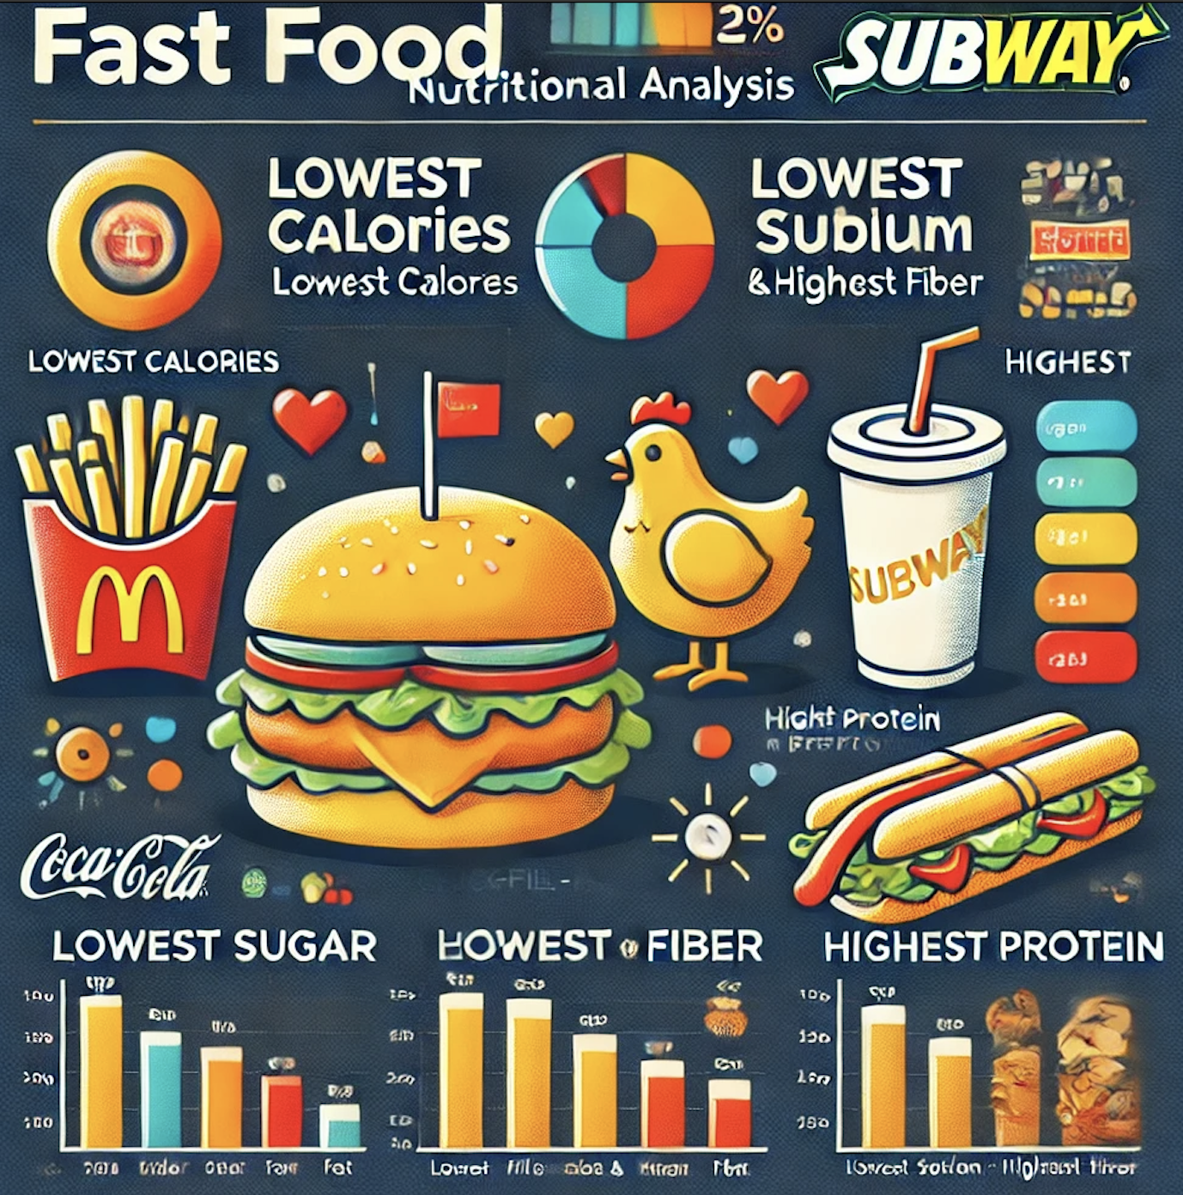
Conclusions
Original Problem: Assess healthiness of fast food based on nutritional content.
Findings:
McDonald's: Lowest calories.
Chick-fil-A: Lowest sugar and fat.
Subway: Lowest sodium, highest fiber.
Sonic: Highest protein.
Notes:
Findings:
McDonald's: Lowest calories.
Chick-fil-A: Lowest sugar and fat.
Subway: Lowest sodium, highest fiber.
Sonic: Highest protein.

Slide 13


Amir Alessia Houleye Paola

